Slide 1


Slide 2
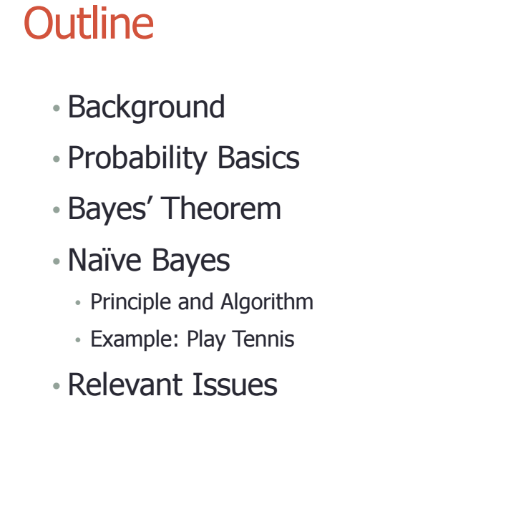

Slide 3
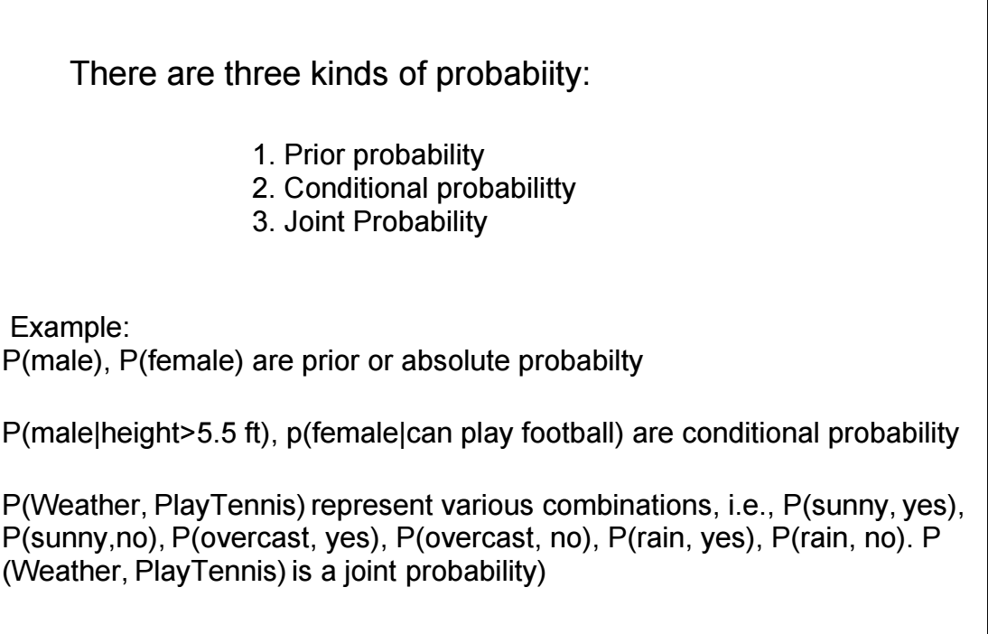

Slide 4
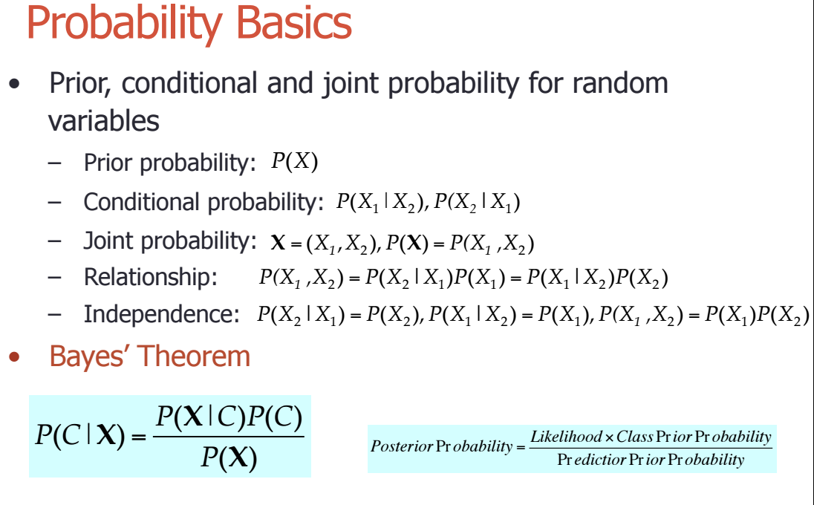

Slide 5
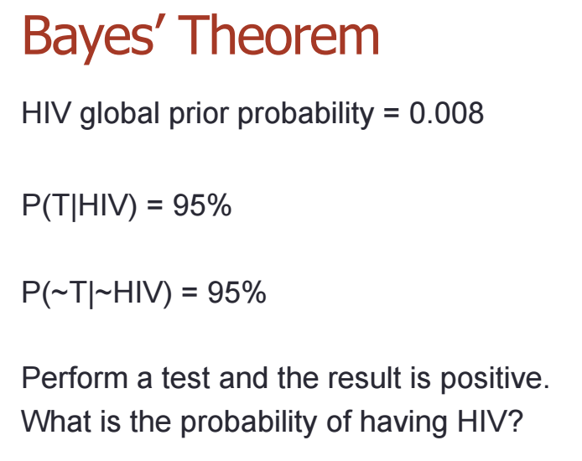
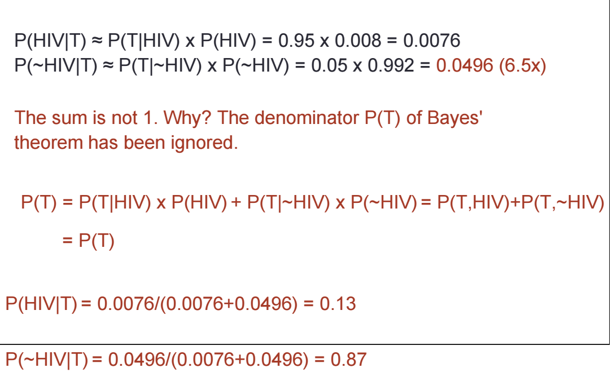

Slide 6
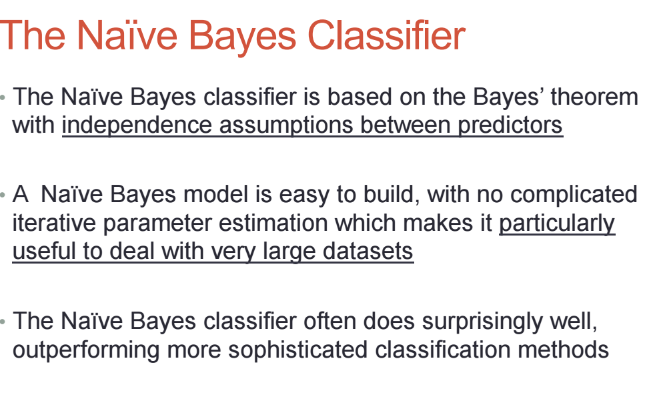

Slide 7
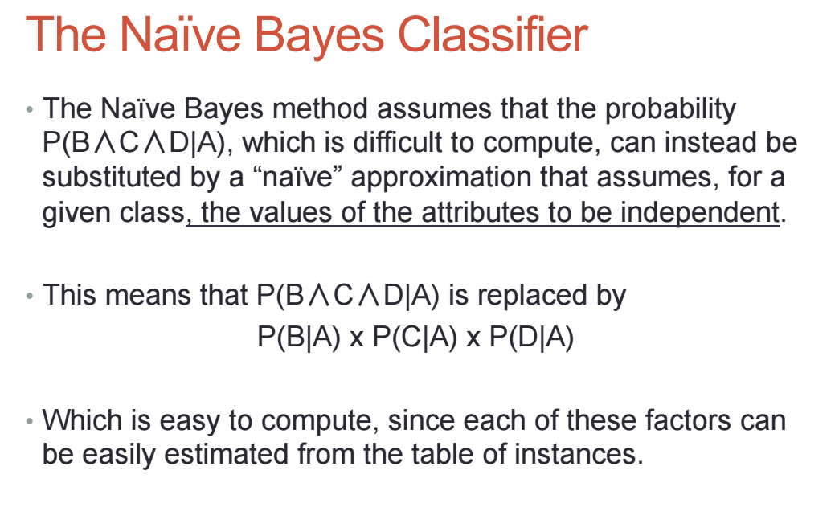

Slide 8
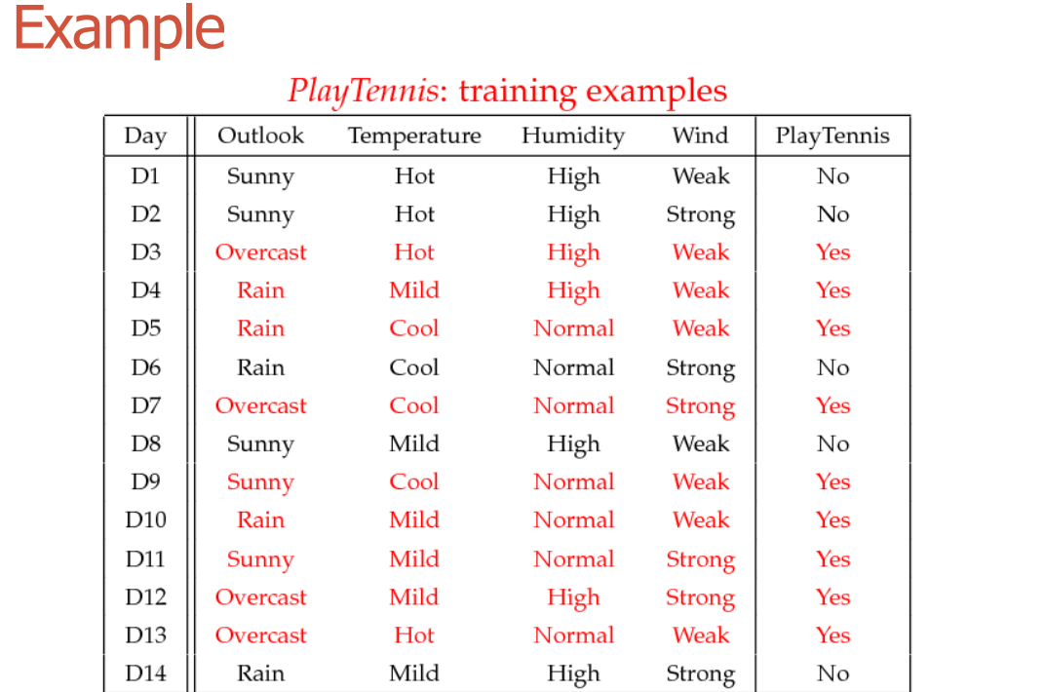

Slide 9
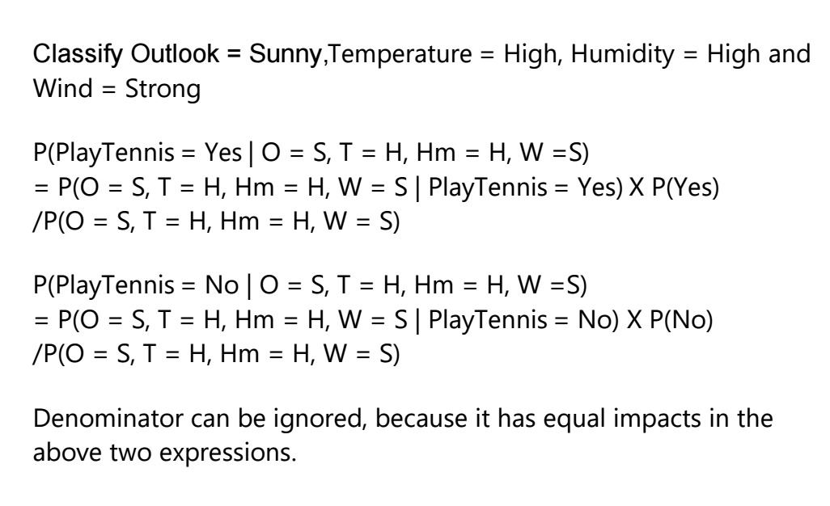

Slide 10
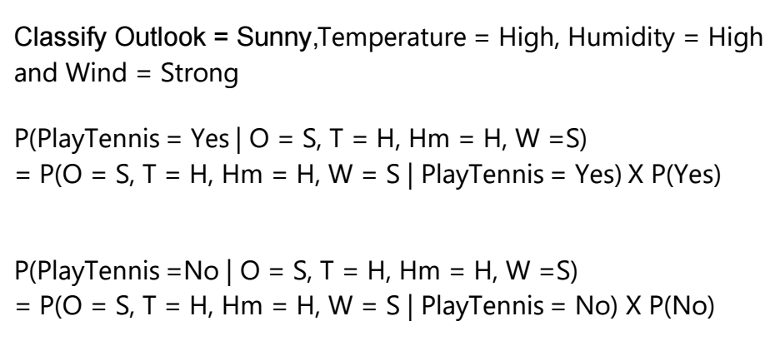
P(Yes |O = S, T = H, Hm = H, W = S) = P ( O = S | Yes) P( T = h| yes) P(Hm = h | Yes) P(W = S|Yes) P(Yrs)
= 2/9 * 2/9*3/9*2/9 * 9/14 = 0.033
P(No| O = S, T = H, Hm = H, W = S) = P ( O = S | No) P( T = h| No) P(Hm = h | No) P(W = S|No) P(No)
= 3/5 * 2/5*4/5*2/5*5/14 = 0.027
The prediction is Yes

Slide 11
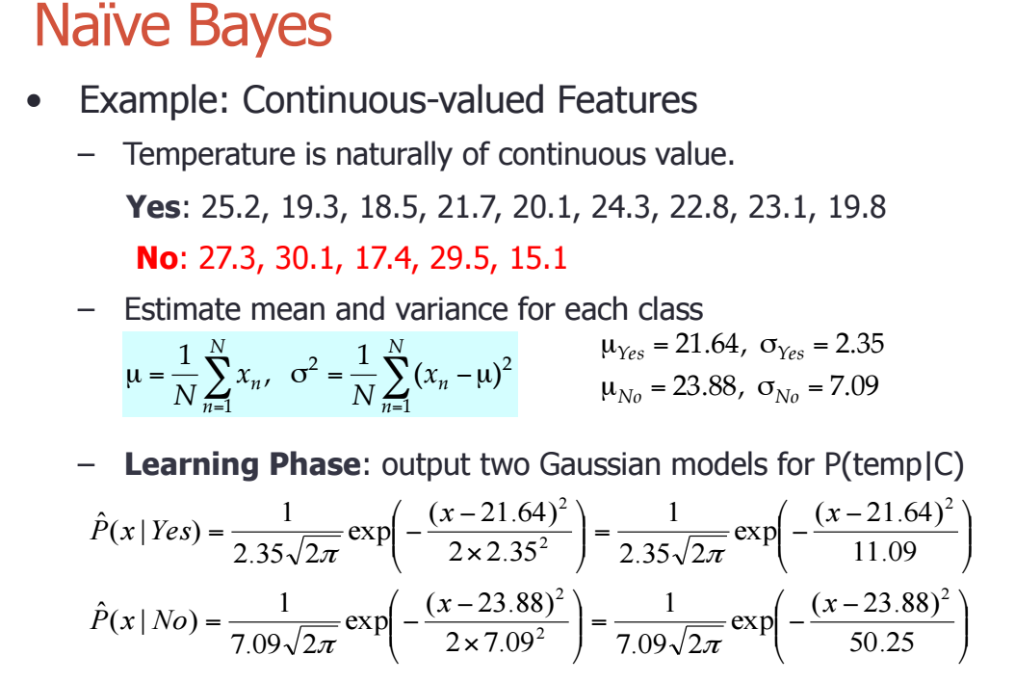

Slide 12
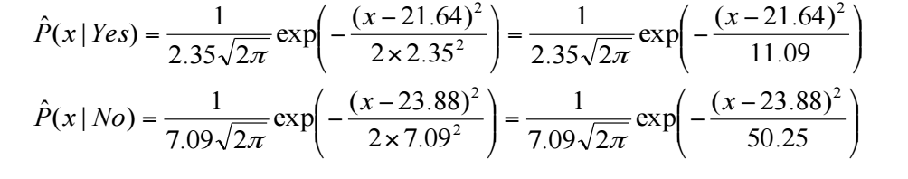
Classsify Outlook = Sunny, Temp = 25, Humidity = High and Wind = Strong
P( Temp = 25 | yes) = 0.061
P( Temp = 25 } No) = 0.055
P(Yes |O = S, T = 25, Hm = H, W = S) = P ( O = S | Yes) P( T = 25| yes) P(Hm = h | Yes) P(W = S | Yes) P(Yes)
= 2/9 * 0.061*3/9*2/9 * 9/14 = 0.0006
P(No| O = S, T = 25, Hm = H, W = S) = P ( O = S | No) P( T = 25| No) P(Hm = h | No) P(W = S|No) P(No)
= 3/5 * 0.055*4/5*2/5*5/14 = 0.004
Prediction is No

Slide 13
